Slide 1
MHS French Immersion TRIP
February 5 - February 20, 2016

Slide 2
Agenda
Introduction
Itinerary
How to pack
Insurance
Q & A

Slide 3
Friday, February 05, 2016
Leave MSH at 1:30 (after 6th Period) – Metz Transportation from Main Lobby
Leave Philadelphia – American Airlines # 564 – Departure 6:30 PM
Arrive at 2PM in Lyon (Part Dieu train station)
Students go directly to exchange family home

Slide 4
Monday, February 08 through Friday, February 12, 2016
Welcome Breakfast
Izieu Orphanage
Tour of Lyon
Brou Monastery in Bourg
Medieval town of Pérouges
Classes at Lycée Saint Pierre

Slide 5
Saturday, February 06 and Sunday, February 07, 2016
Arrive Charles de Gaulle Airport – 7 :55AM
Depart Charles de Gaulle TGV #5164 for Lyon Part Dieu – 1 :58 PM
Arrive Lyon – 4:00 PM
Weekend with families

Slide 6
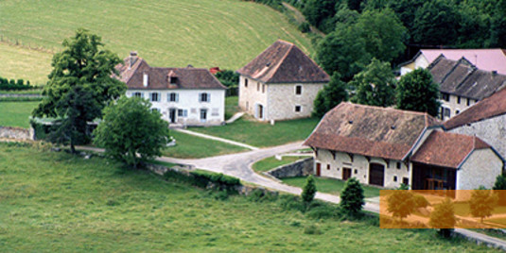
Izieu
Izieu was the site of a Jewish orphanage during the Second World War. Most of the children were sent purposely in the Savoy mountains which was then under Italian rule, and at that time less oppressive.
On 6 April 1944, three vehicles pulled up in front of the orphanage. The Gestapo under the direction of the 'Butcher of Lyon' Klaus Barbie, entered the orphanage and forcibly removed forty-four children and their seven supervisors, and sent them to Auschwitz.

Slide 7
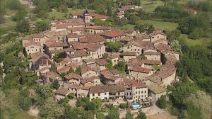
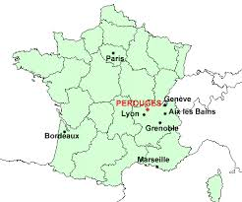
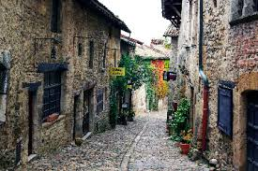
PÉROUGES
Pérouges is a popular tourist attraction that is a restored medieval walled town, located 30 km northeast of Lyon. Today it is the home to approximately 500 residents.

Slide 8
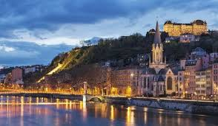
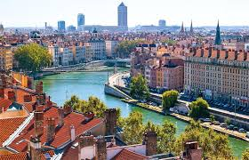
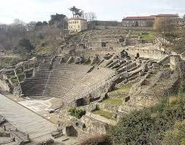
LYON
Lyon, a city in France’s Rhône-Alpes region, sits at the confluence of the Rhône and Saône rivers. Its city center reflects 2,000 years of history, with a Roman amphitheater, medieval and Renaissance architecture in Vieux Lyon, and the modern, redeveloped Confluence district. It is the 3rd largest city in France, but France’s 2nd largest metropolitan area. It is considered the world capital of gastronomy.

Slide 9
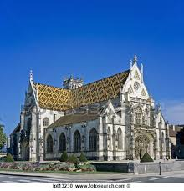
BROU Monastery
The Gothic style church and monastery, located in Bourg en Bresse was built in the 16th century by Margaret of Austria, daughter of the Holy Roman Emperor Maximillian I. The tall roof is covered in colored, glazed tiles.

Slide 10
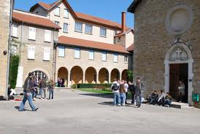
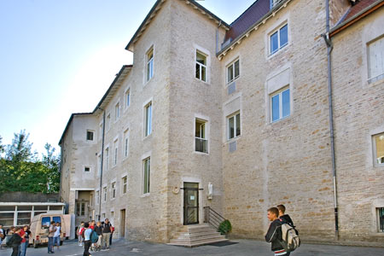
Lycée Saint Pierre
Address: 7 Rue Villeneuve, 01000 Bourg-en-Bresse, France
Phone:+33 4 74 32 10 90

Slide 11
Saturday, February 13, 2016 through Wednesday, February 17, 2016
Language and Cultural Immersion on holiday with host families
Farewell Party

Slide 12
Thursday, February 18 through Friday, February 19, 2016
Depart from Bourg en Bresse train station Lyria # 9760 – 7:36 AM
Arrive Paris Gare de Lyon – 9:27 AM
Tour of Paris – Seine River Tour, Eiffel Tower, L’Arc du Triomphe, Champs Élysées, Louvre, Musée d’Orsay, Notre Dame, Quartier Latin, Sacré Cœur, and more!
Two night Hotel stay at Hotel au Royal Cardinal (1 Rue des Écoles, 75005 Paris, France … Ph: +33 1 43 26 83 64)

Slide 13
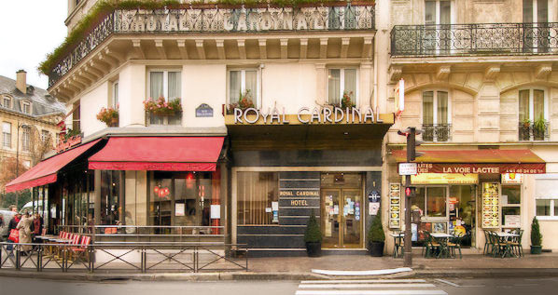
Hôtel Royal Cardinal
Located in the Latin Quarter, the Hotel Royal Cardinal is a 5 minute walk from the metro; therefore, affording easy access to most of the tourist attractions in Paris.

Slide 14
Final Week Assignment!!!
Make sure you have spoken to all of your teachers to secure assignments
Photocopy as much as you can so you do not have to bring too many books with you!!!
Pack as light as possible – remember gifts for family, mini-umbrella, camera – bring your passport and your school ID with you for discounts!!!
Don’t pack money in your checked luggage – keep it with you! Pack an extra change of clothes – shirt and underwear at least!!! in your on-board bag.

